Slide 1

The Relation of Physics to Other Sciences
Richard Feynman (1963) wrote,
A poet once said, “The whole universe is in a glass of wine.”… If our small minds, for some convenience, divide this glass of wine, this universe, into parts—physics, biology, geology, astronomy, psychology, and so on—remember that nature does not know it! So let us put it all back together, not forgetting ultimately what it is for. Let it give us one more final pleasure: drink it and forget it all!

Slide 2
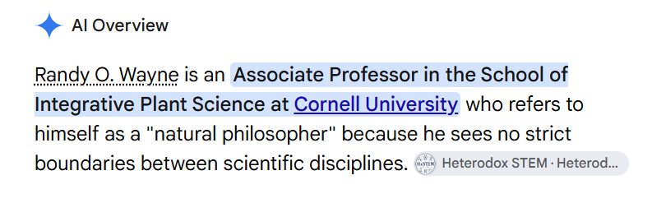

Slide 3


Slide 4

Take out your cell phone and ask AI,
“Is an understanding of light important for a botanist?”

Slide 5
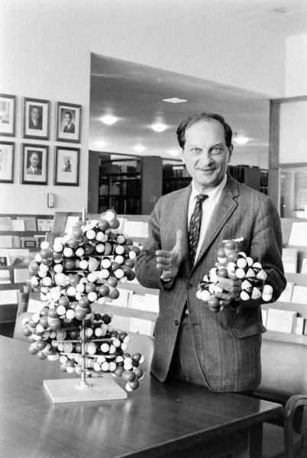

Ask not what physics can do for biology, ask what biology can do for physics
Stanislaw Ulam

Slide 6
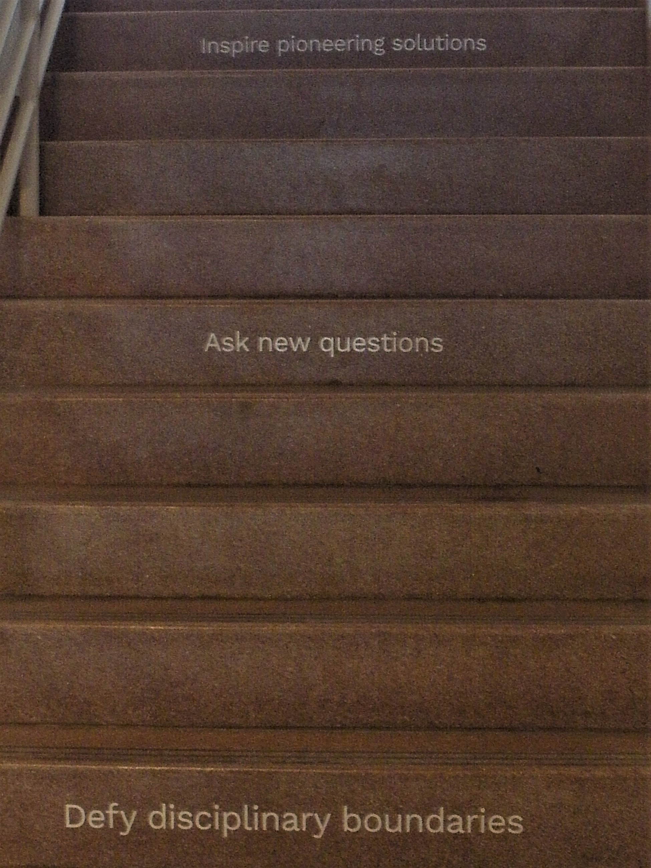
To ensure that you do not get a raise or a promotion,
please follow the following rules:

Slide 7
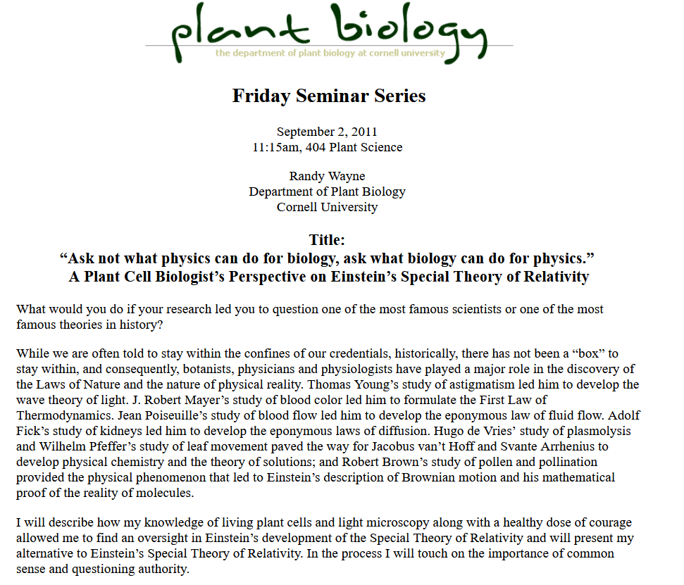

Slide 8


Slide 9
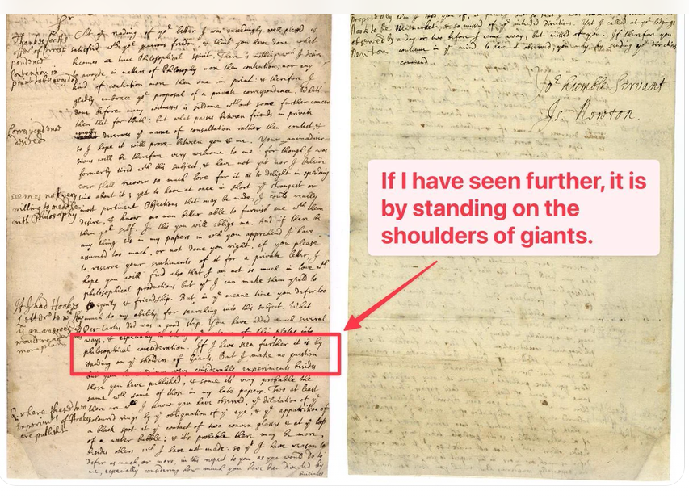
A Digression
Isaac Newton wrote in a letter to Robert Hooke on February 5, 1675 regarding work on light:
What Des-Cartes did was a good step. You have added much several ways, & especially in taking the colours of thin plates into philosophical consideration. If I have seen further it is by standing on the shoulders of Giants.

Slide 10
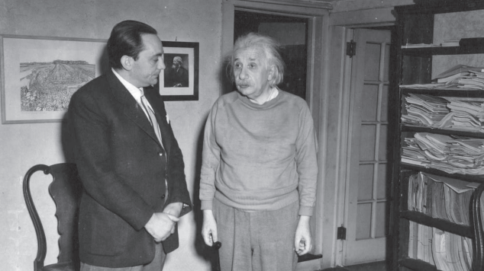
When Einstein made his first visit to the United Kingdom, the press asked him if he had stood on the shoulders of Newton. Einstein replied, “That statement is not quite right. I stood on Maxwell’s shoulders.”

Slide 11
Picture of James Clerk Maxwell
When Einstein made his first visit to the United Kingdom, the press asked him if he had stood on the shoulders of Newton. Einstein replied, “That statement is not quite right. I stood on Maxwell’s shoulders.”

Slide 12
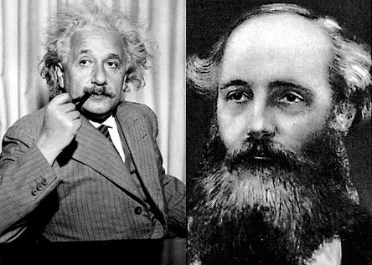
The Connection between Einstein and Maxwell is not Trivial
The special theory of relativity owes its origin to Maxwell's equations of the electromagnetic field.”
Albert Einstein (1949) In Albert Einstein: Philosopher Scientist.

Slide 13

Postulates of the Special Theory of Relativity
The First Postulate (Principle of Relativity): The laws of physics are identical in all inertial frames of reference.
The Second Postulate (Invariance of the Speed of Light): The speed of light in a vacuum is a constant value (c), independent of the motion of the light source or the observer.
Einstein considered Maxwell’s wave equation, which includes the constant speed of light, c, a law of physics.

Slide 14
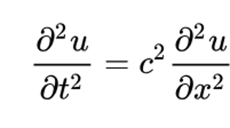
Einstein on Maxwell
...partial differential equations appeared as the natural expression of the primary realities of physics.
Maxwell showed that the whole of what was known at that time about light and electromagnetic phenomena could be represented by his famous double system of partial differential equations, in which the electric and the magnetic fields made their appearance as dependent variables.

Slide 15
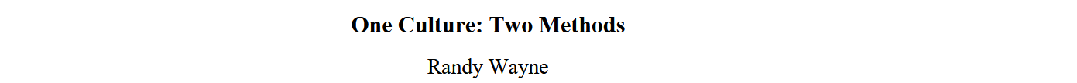
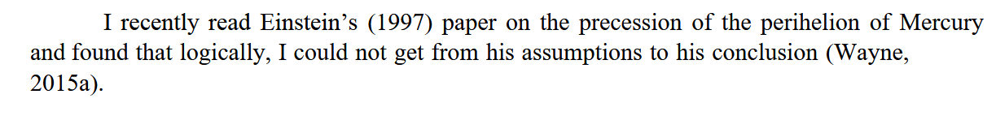
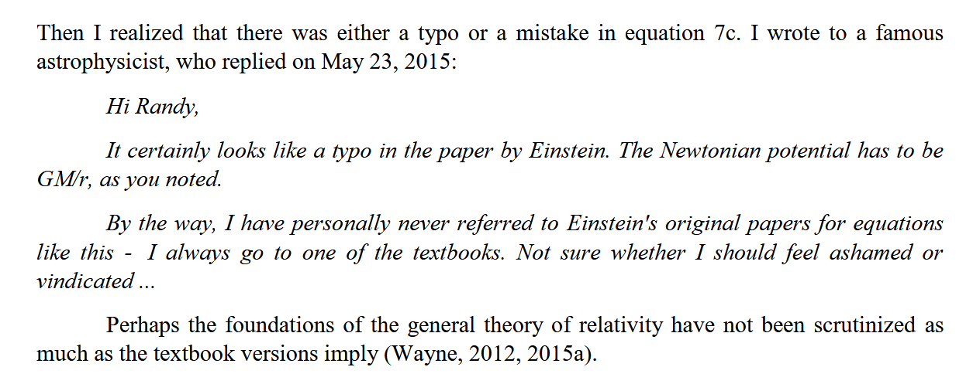
Who is Checking Einstein’s Math?

Slide 16
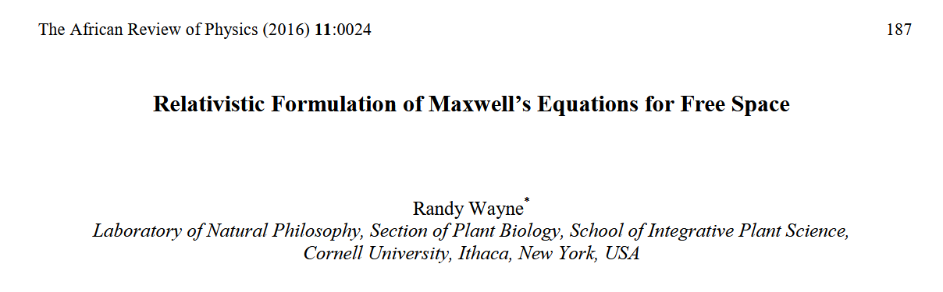

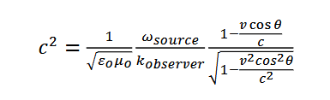

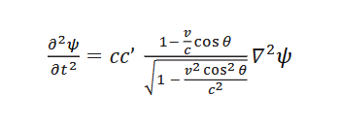
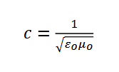


Slide 17
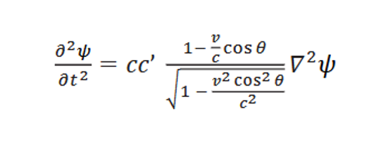
At ∞, Cos θ = 1

Slide 18
At ∞, Cos θ = 1

Slide 19

At v = 0

Slide 20
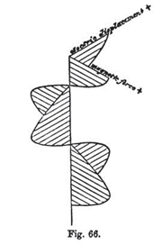

Phase Relations of Maxwell’s Electromagnetic Wave Contradict:
Causality
Conservation of energy
Kirchhoff’s diffraction equation

Slide 21
Phase Relations of Maxwell’s Electromagnetic Wave Contradict:
Causality
Conservation of energy
Kirchhoff’s diffraction equation
Sweep away cognitive dissonance.

Slide 22
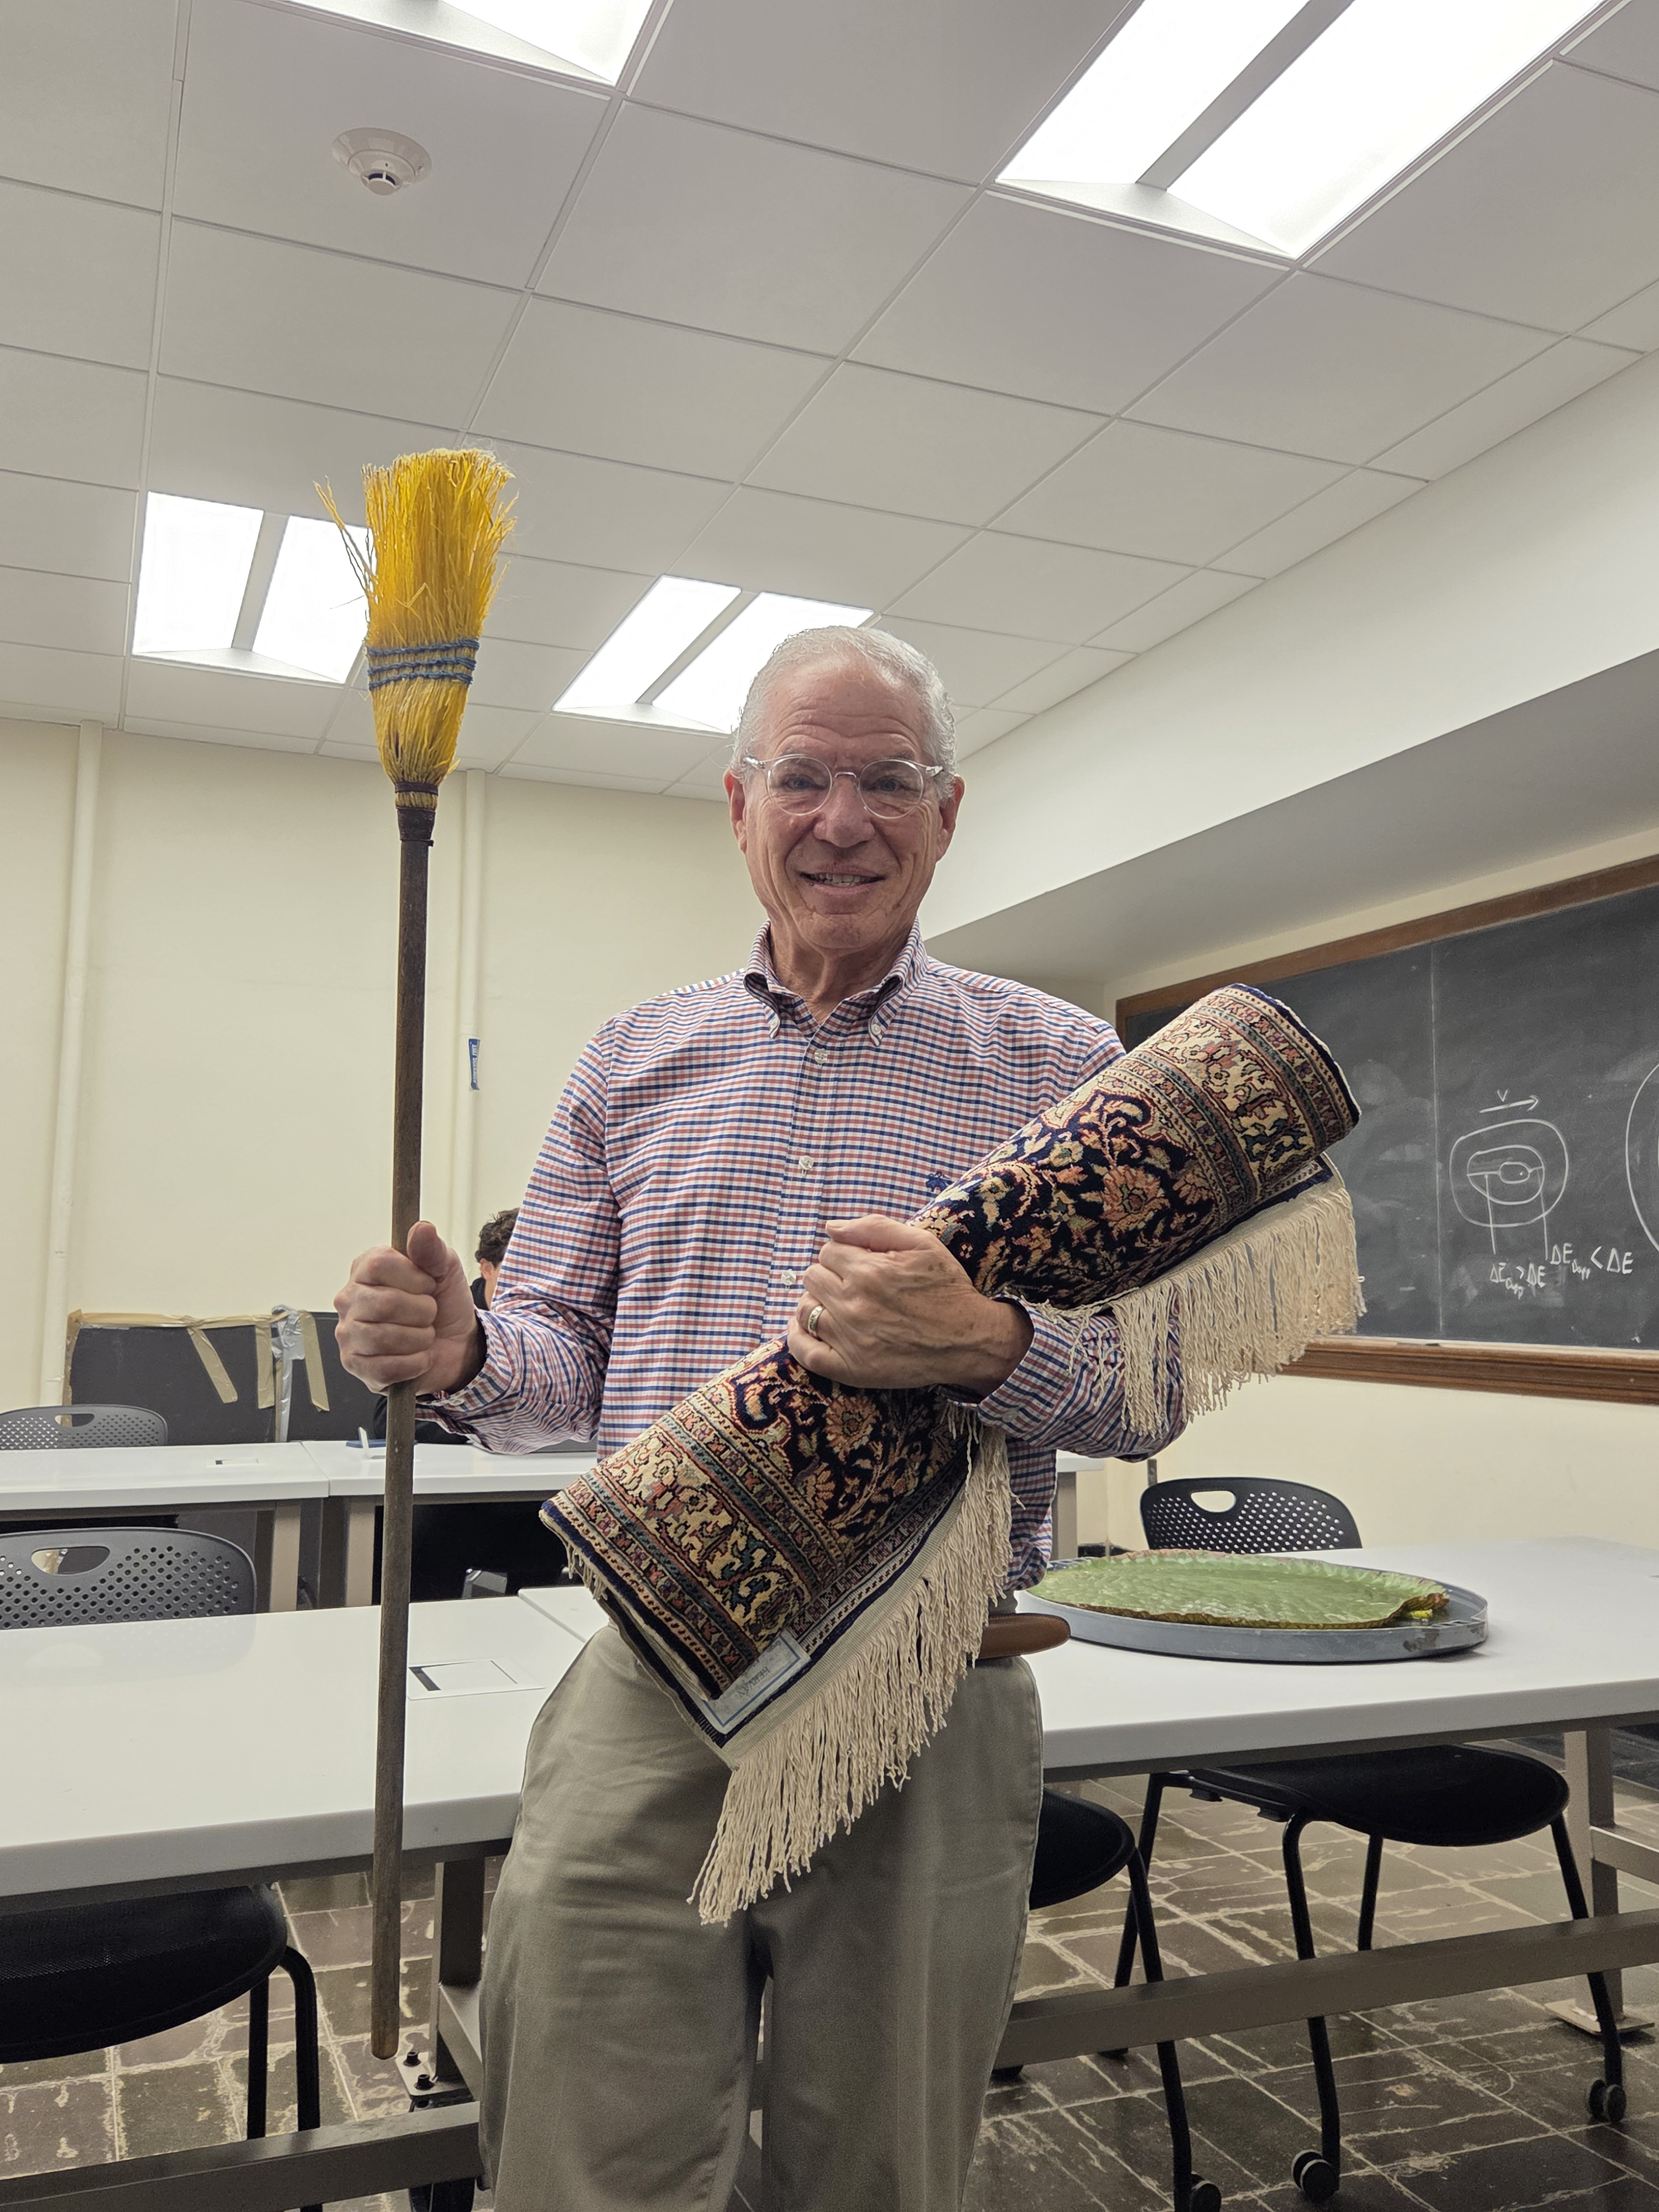

Slide 23
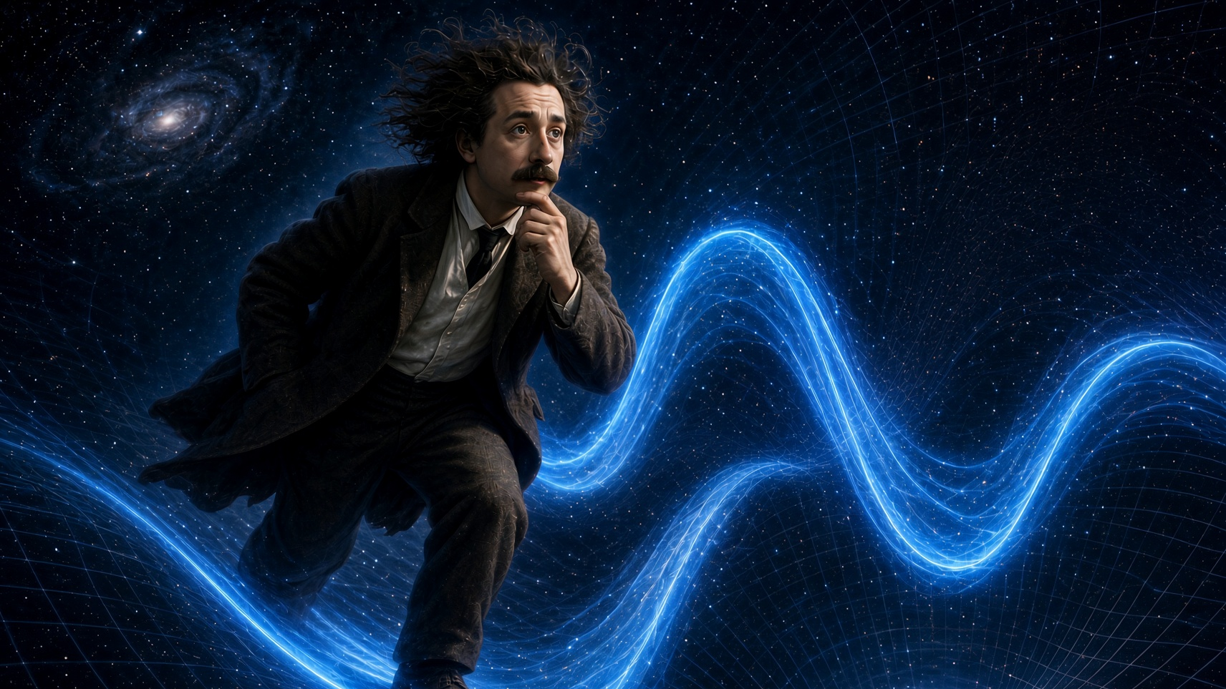

Slide 24
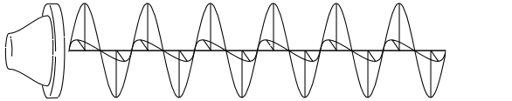
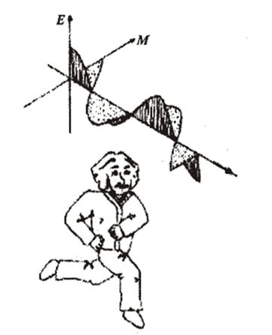
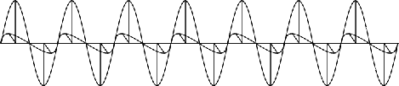
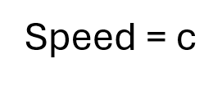
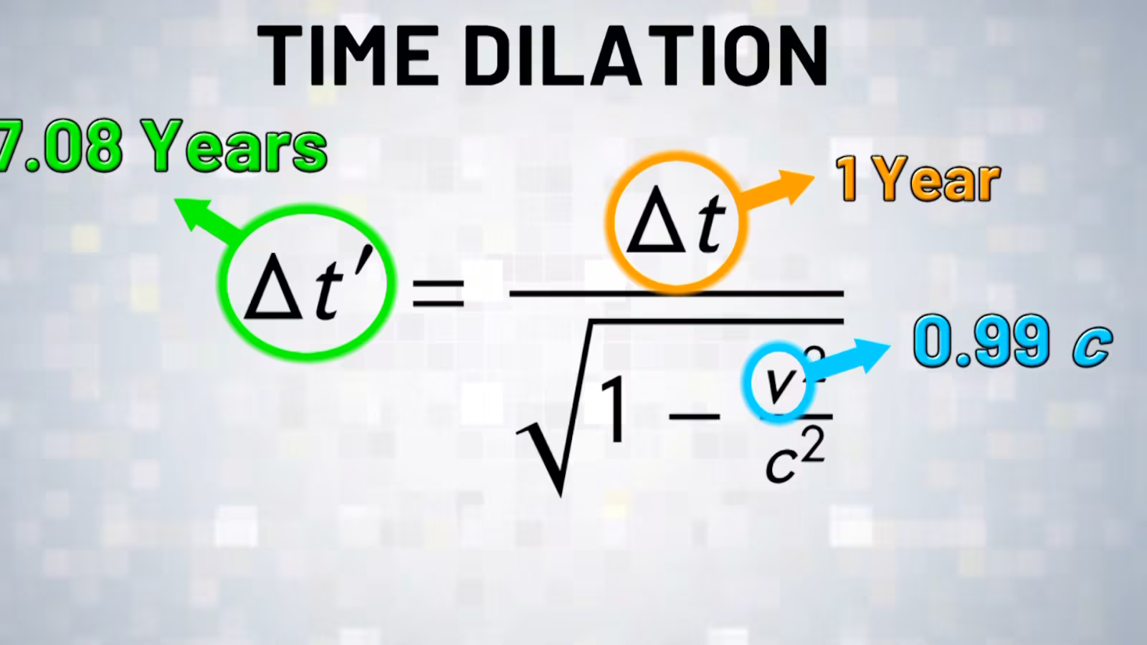
Chasing the Light
Speed = c

Slide 25
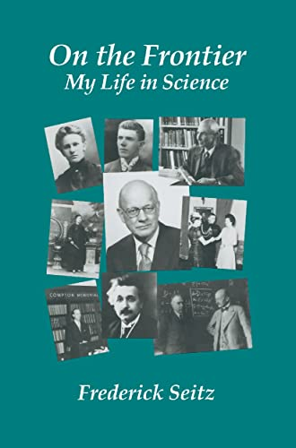
Frederick Seitz
…the theory of relativity appears to have further consequences…It would seem to destroy all the absolutes, and to reduce reality to a quality of the mind.

Slide 26
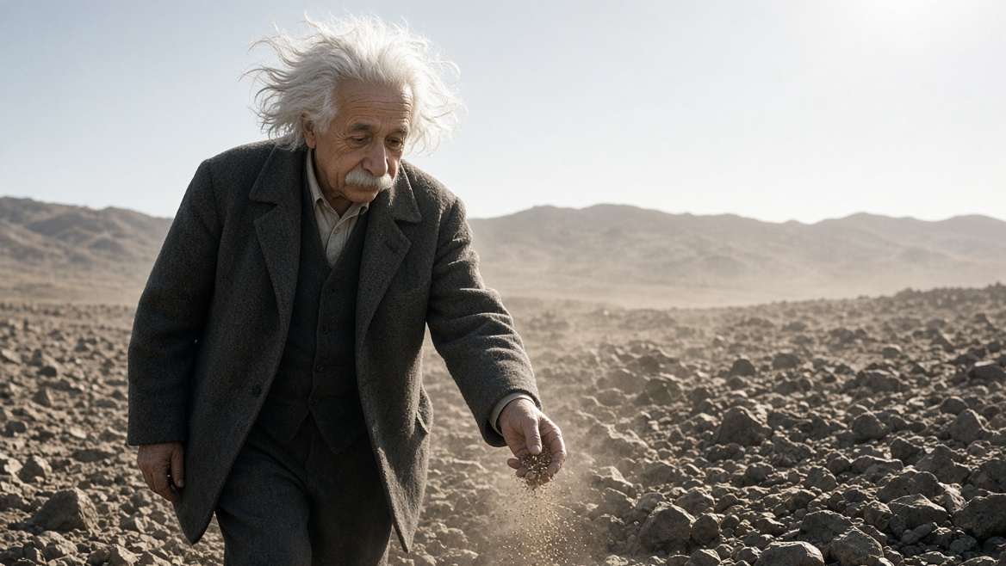

Slide 27


Slide 28
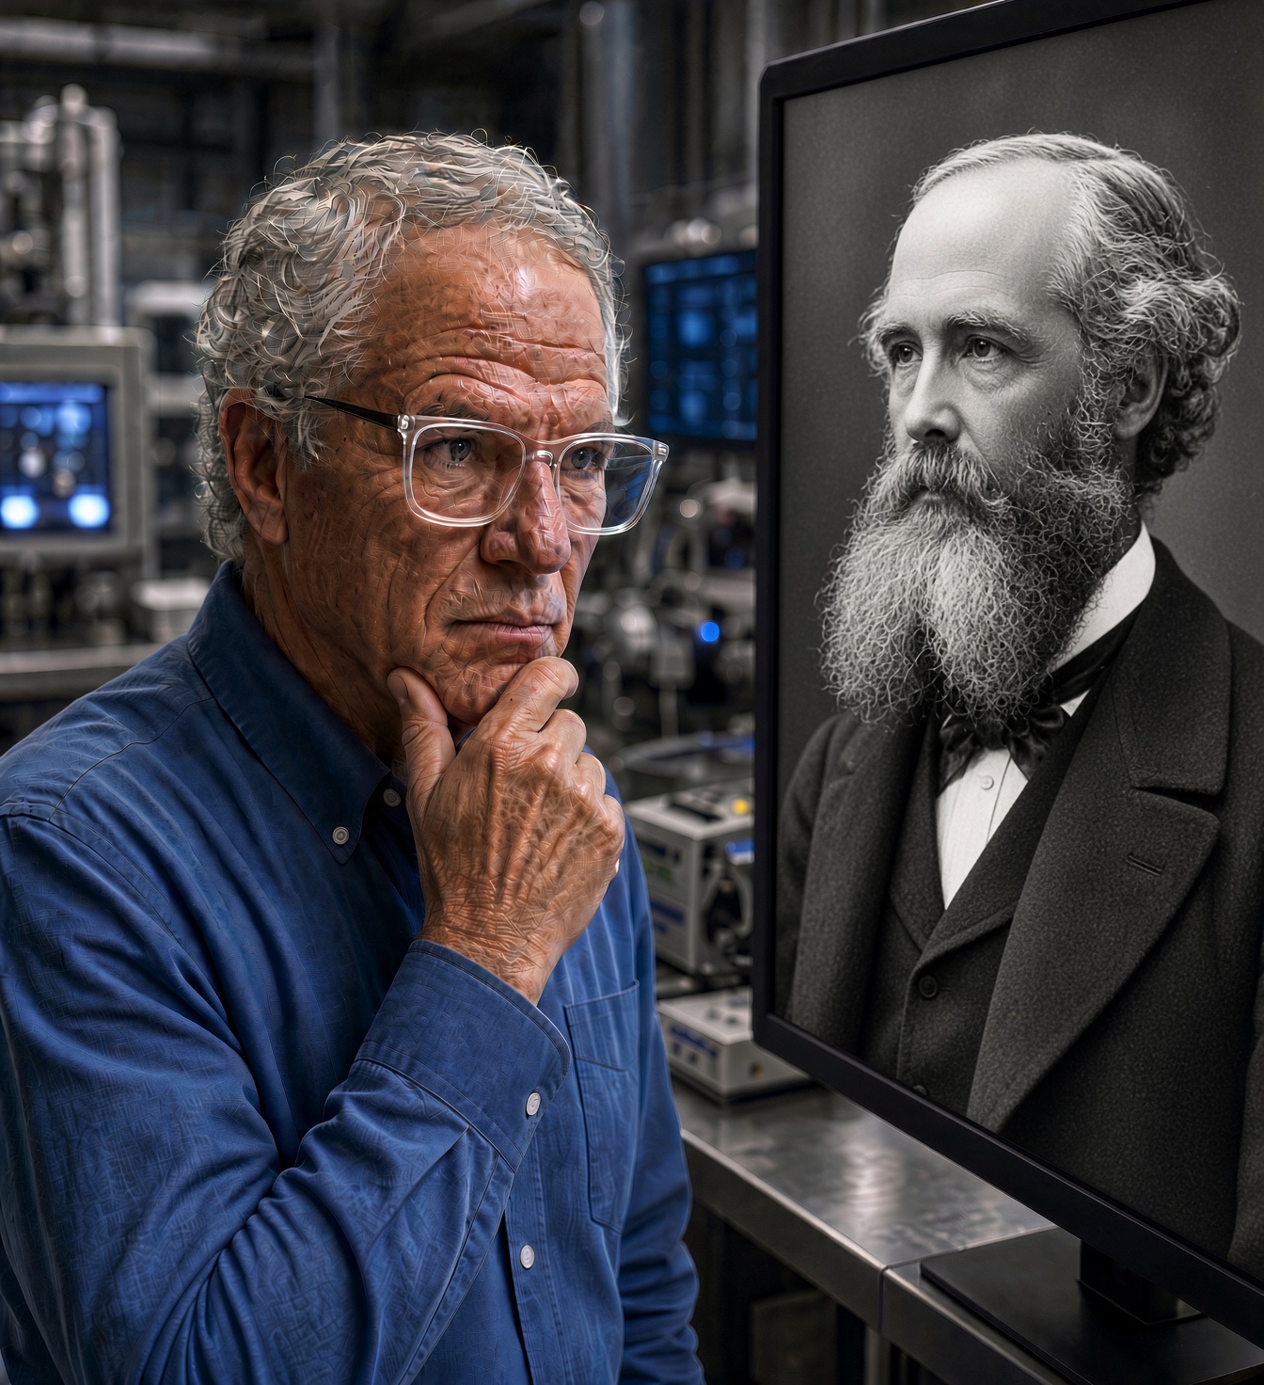
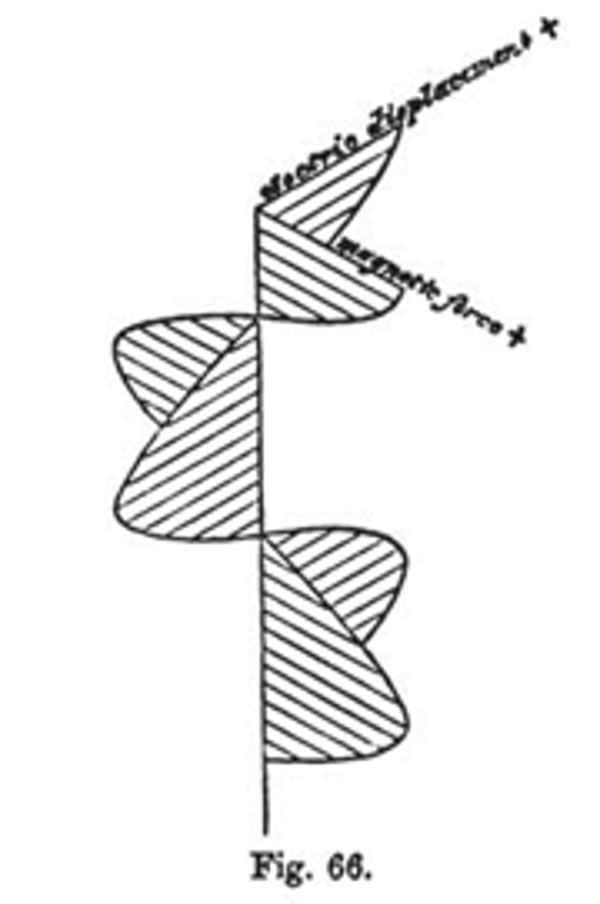
In this presentation, I am questioning James Clerk Maxwell’s model of light, upon which Albert Einstein built his theory of relativity

Slide 30
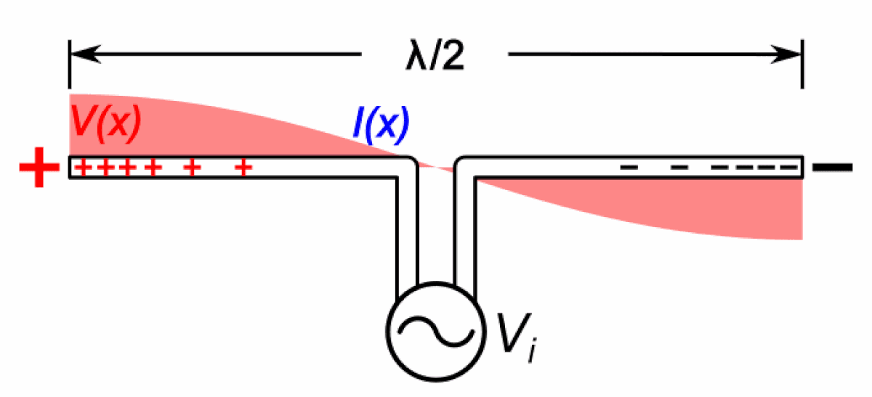



Slide 31

How do waves that start out-of-phase give rise to waves that are in-phase?
There is a magical force (described by mathematical approximations; i.e., tricks) that pulls them together.
or
There is no magic. They start out-of-phase and remain out-of-phase.

Slide 32


Slide 33
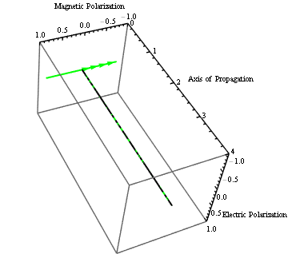

Slide 34
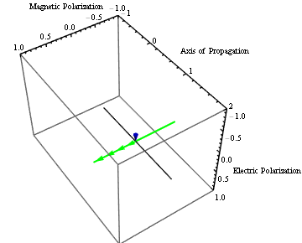

Slide 35
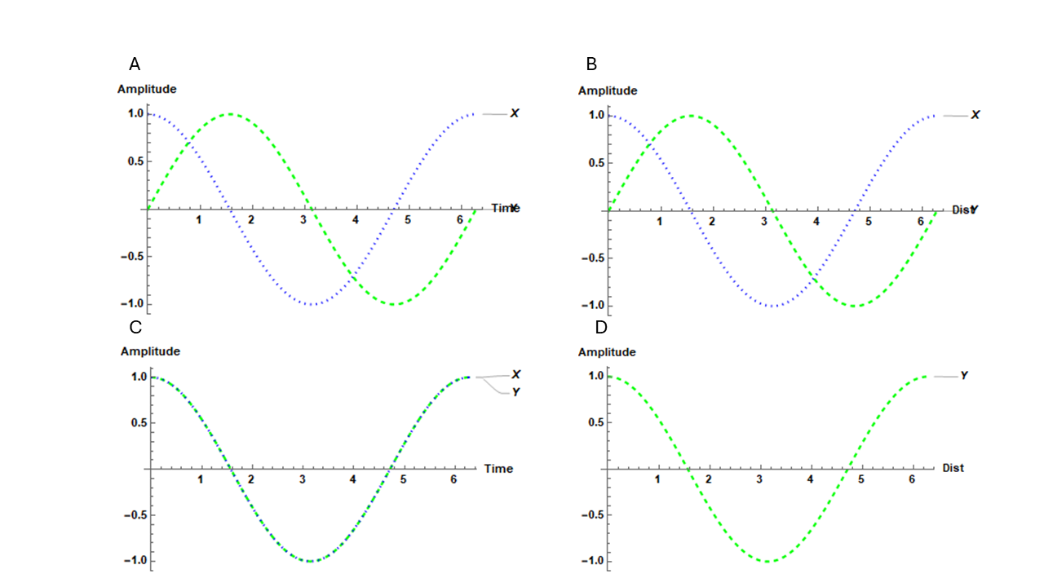
Randy’s
Theory
Maxwell’s
Theory

Slide 36
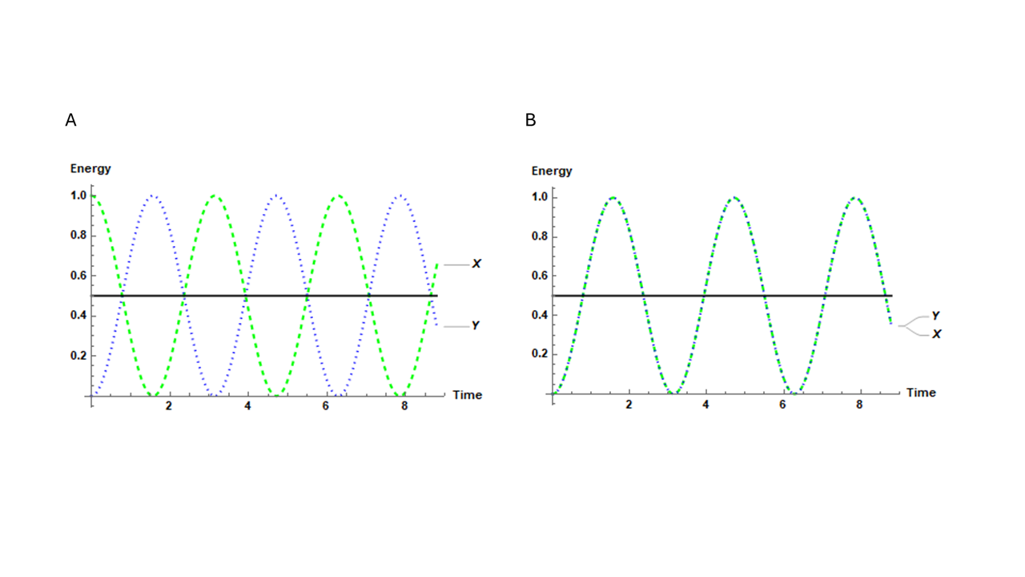
My Theory
Maxwell’s Theory

Slide 37
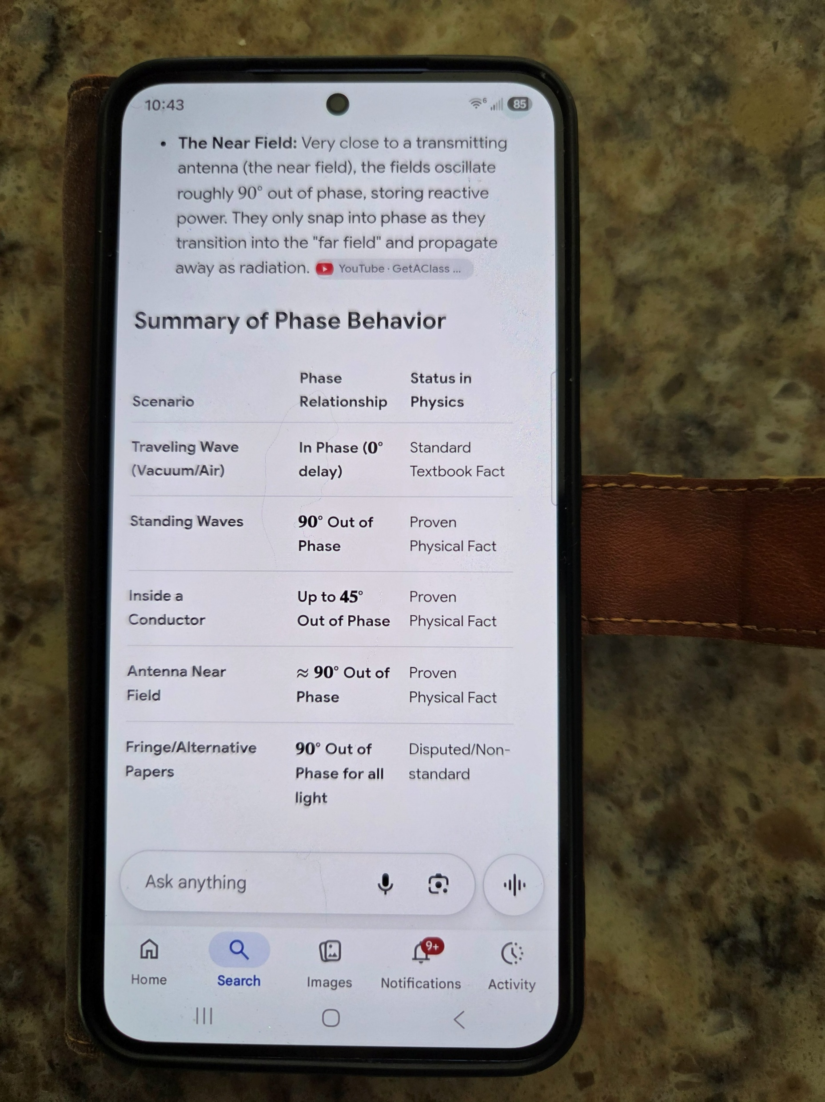

Slide 38

Dear Professor Wayne,
We have received the Academic Editor's feedback attached below:
"The author of this manuscript wants to show he has overturned a basic physical law, which I cannot accept absolutely."
We regret to inform you that we will not be processing your submission further and wish you every success if you choose to pursue publication elsewhere.
Best regards,
Ms. Cornelia Shang
Assistant Editor

Slide 39
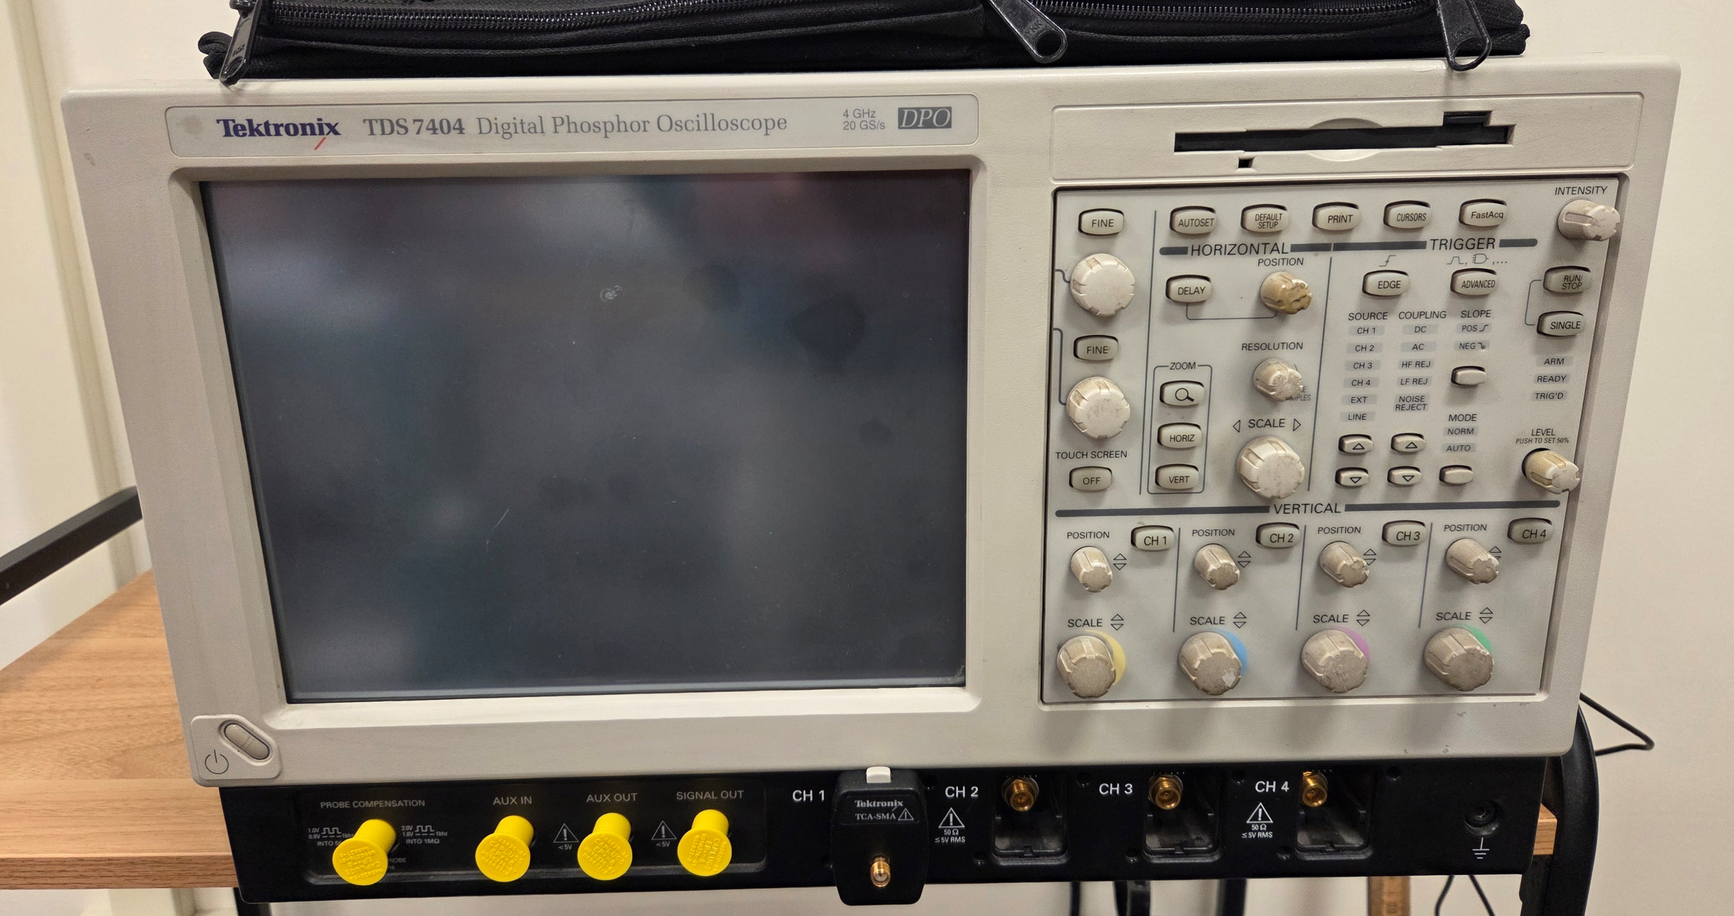

Slide 40
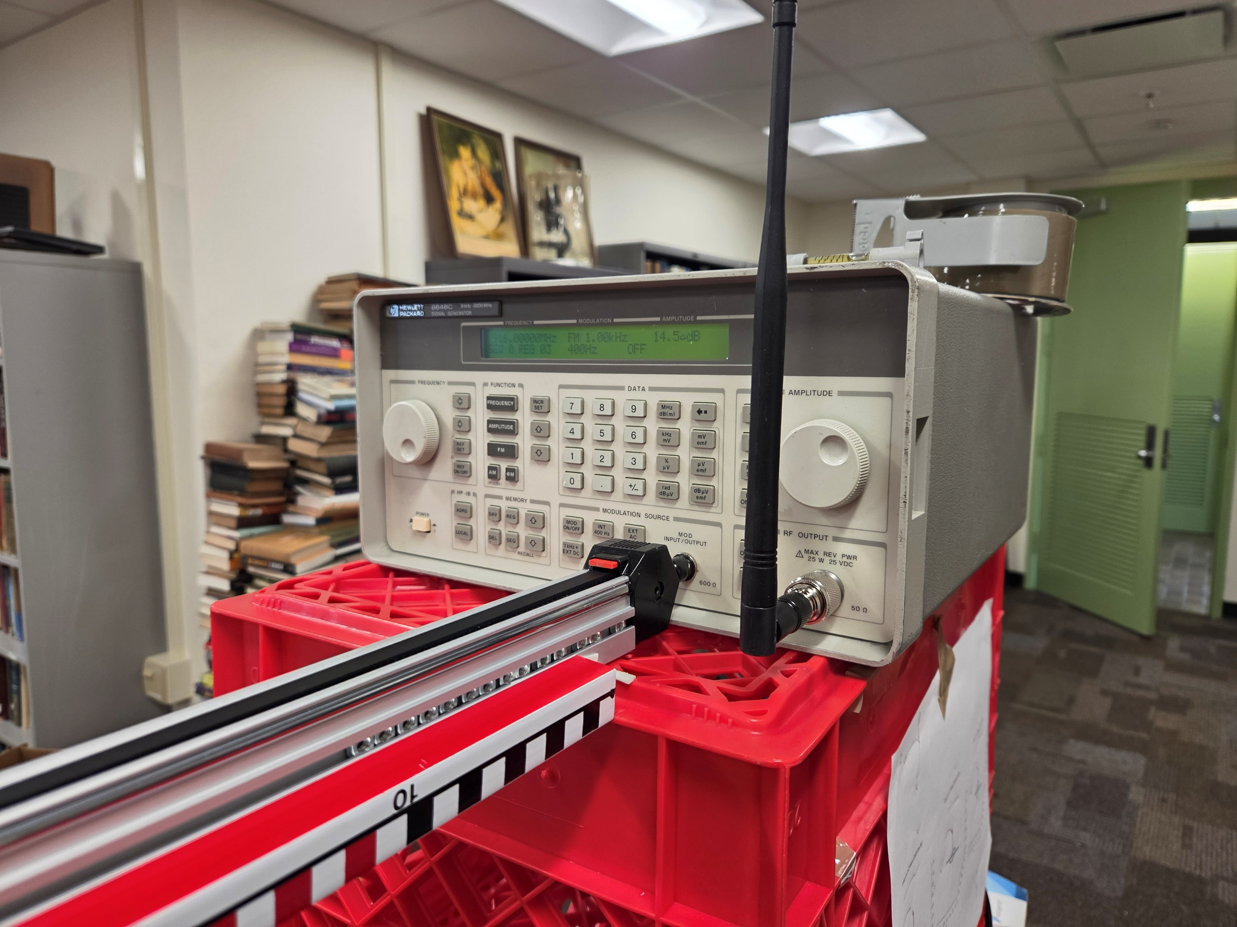

Slide 41
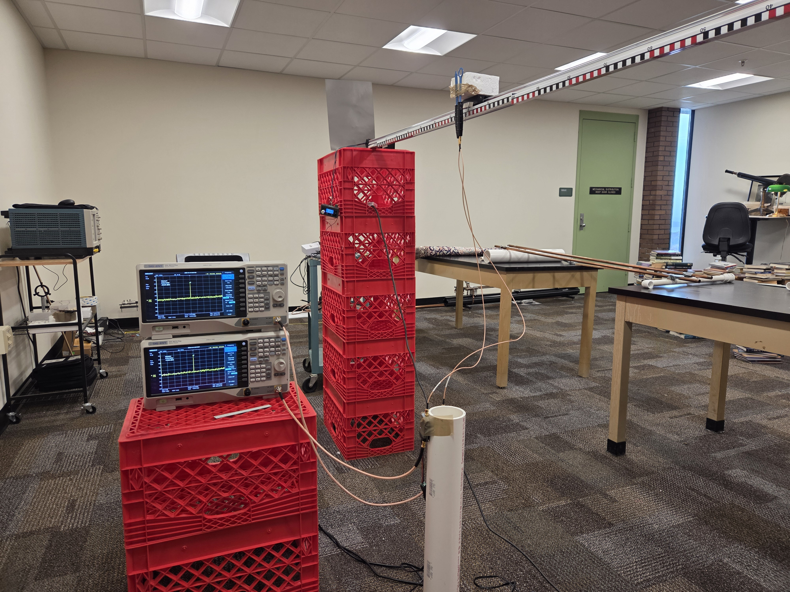

Slide 42
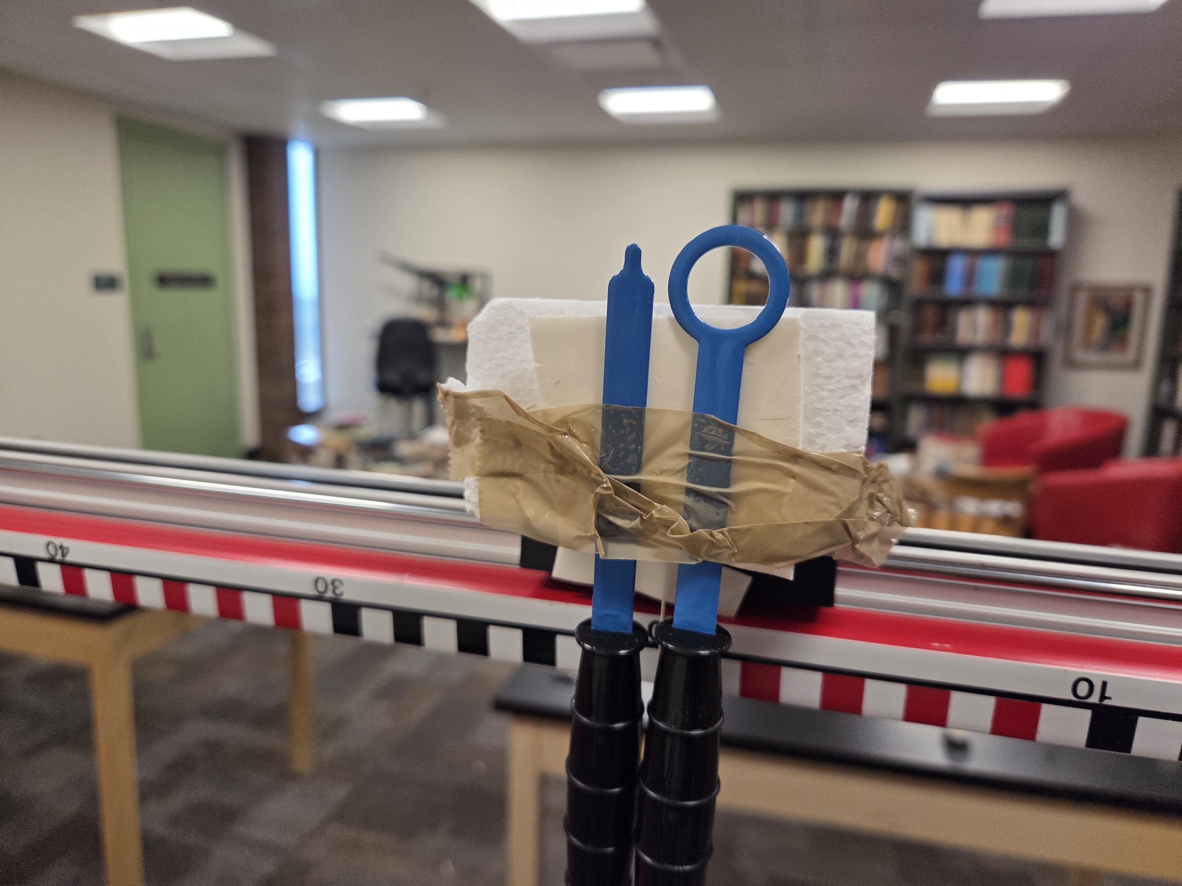

Slide 43
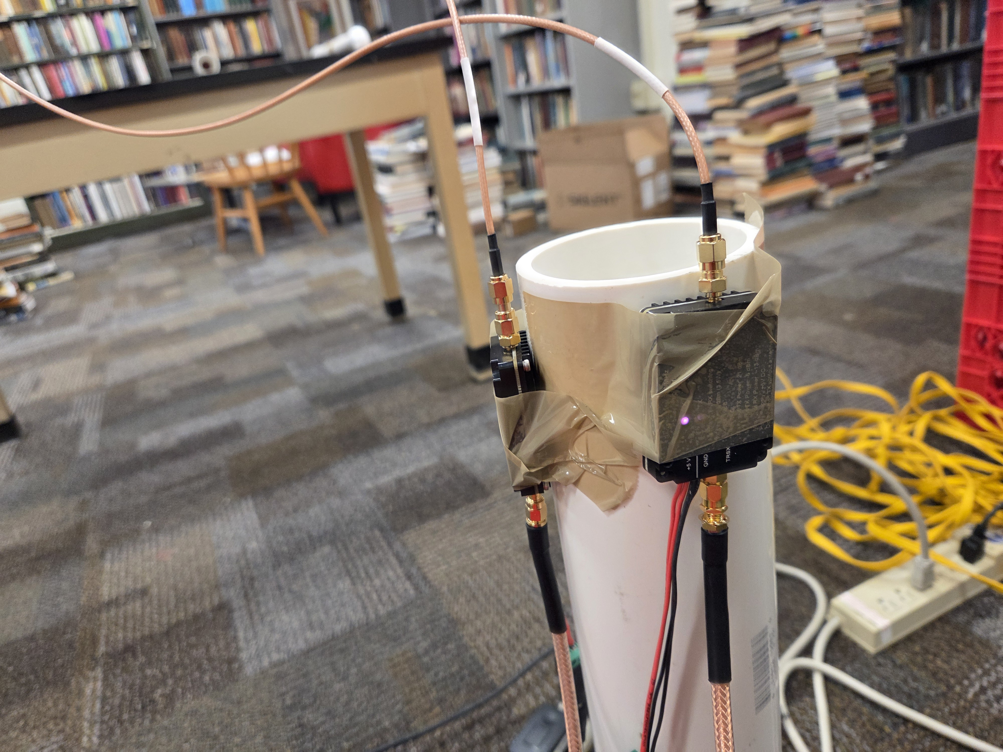

Slide 44
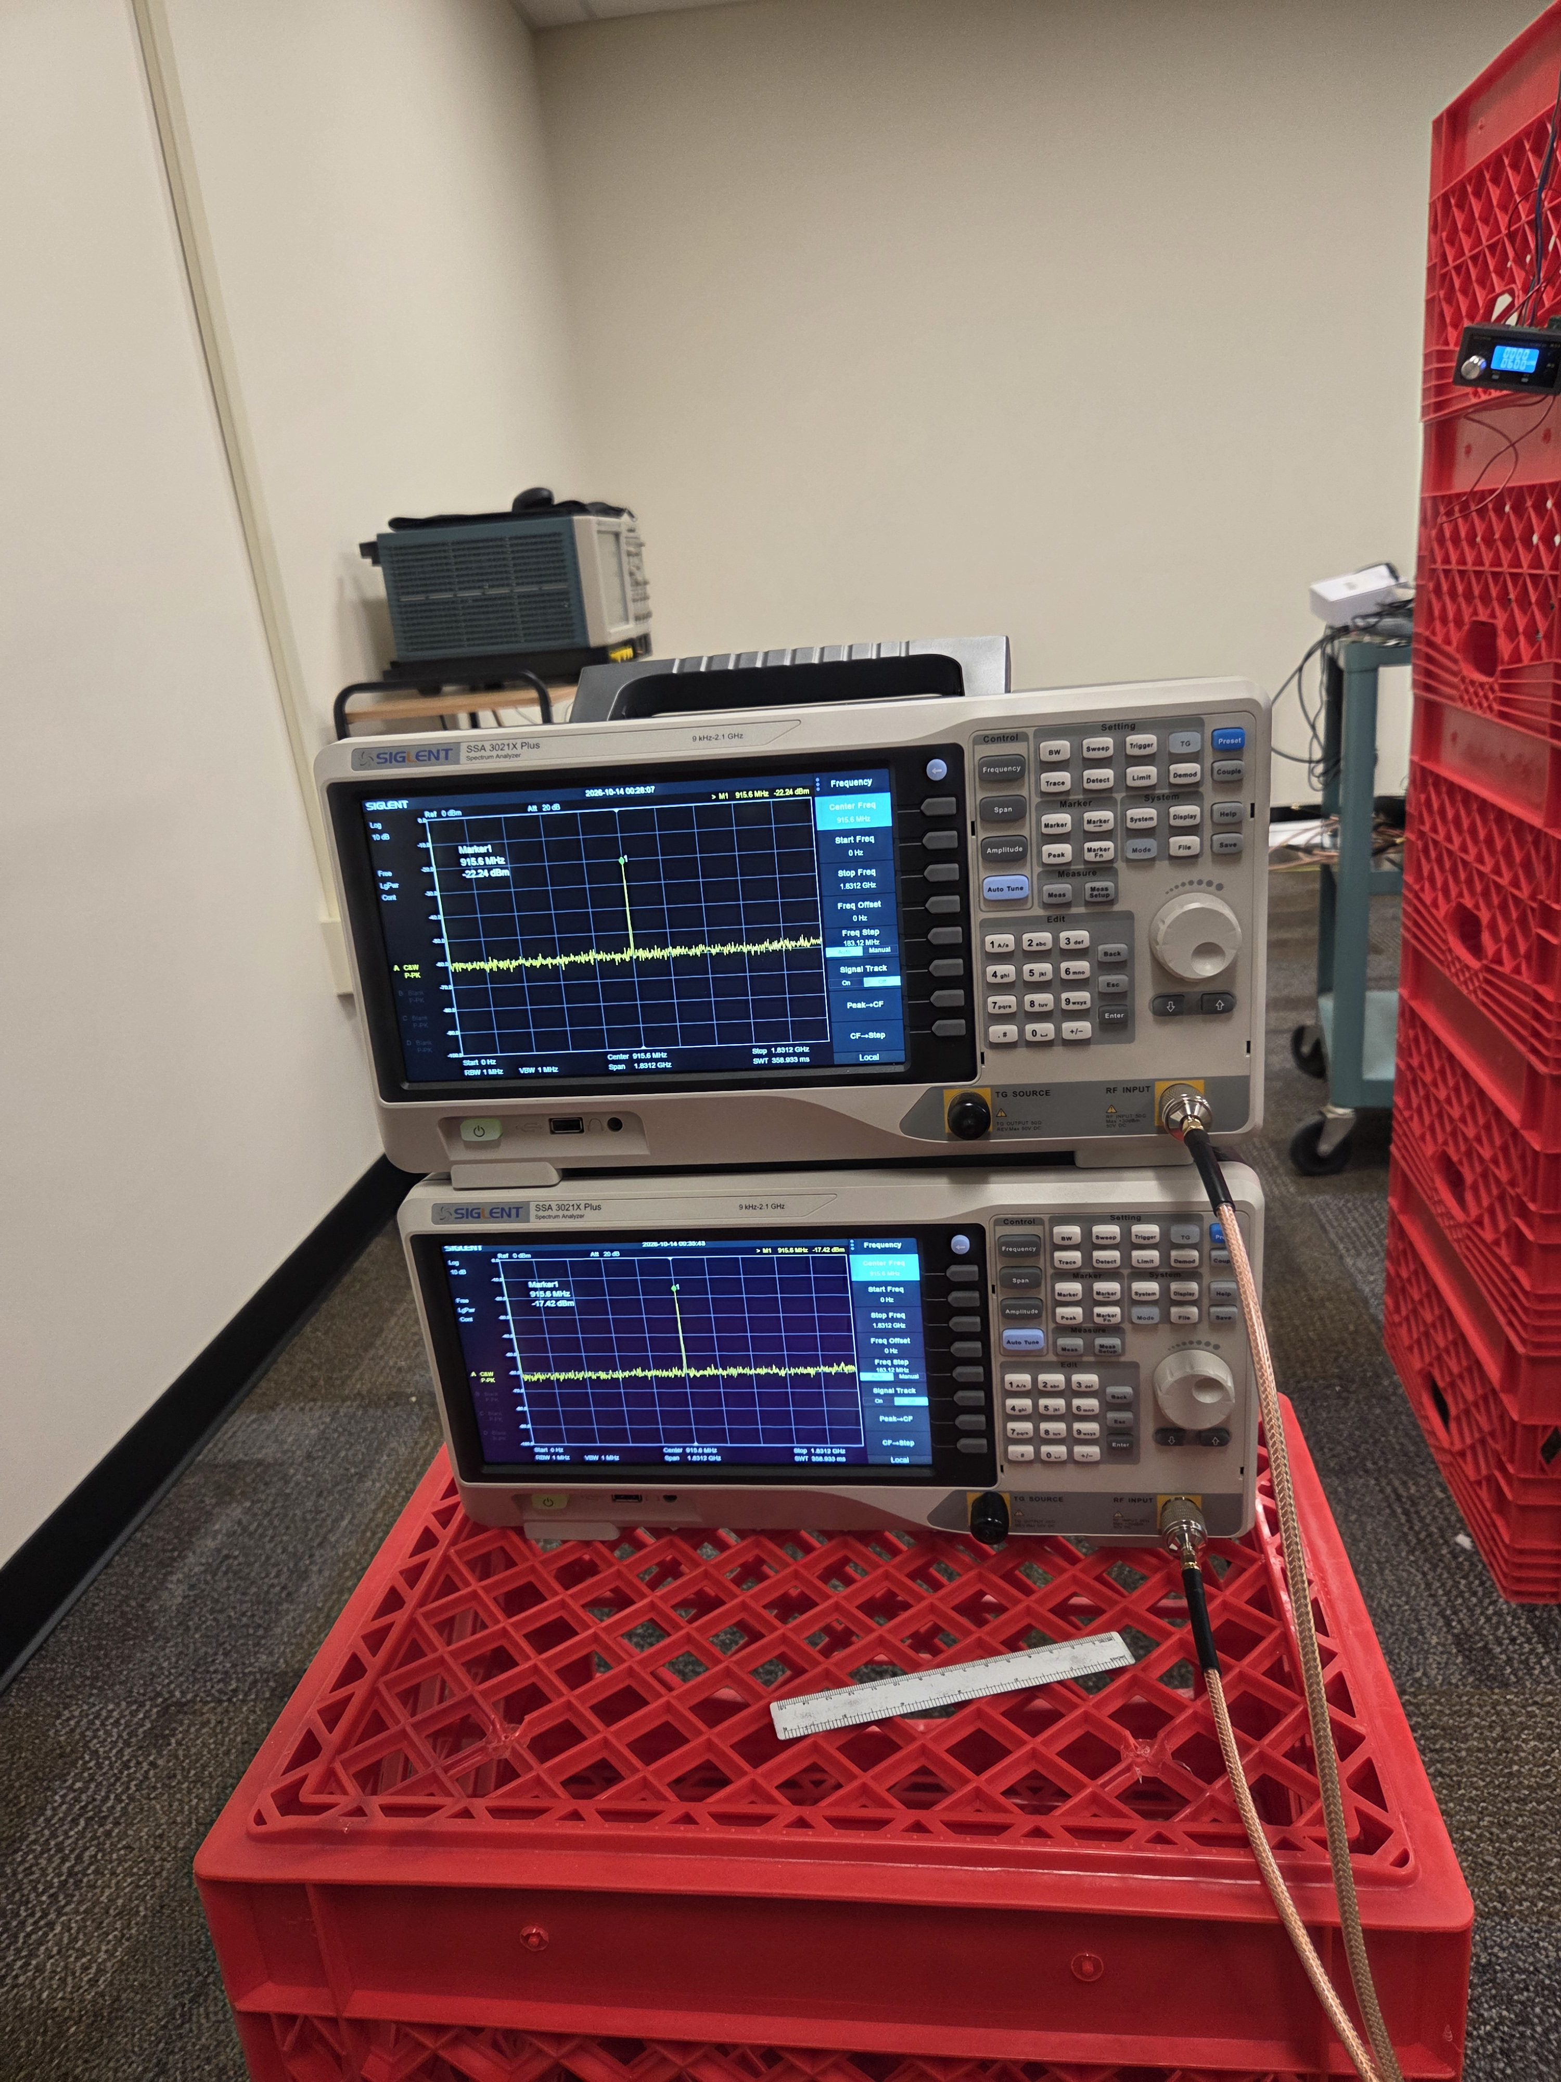

Slide 45
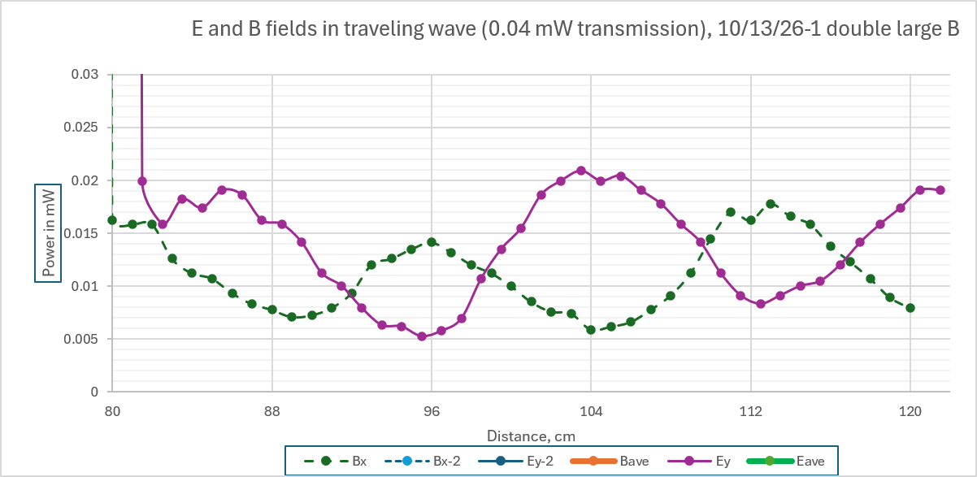

Slide 46
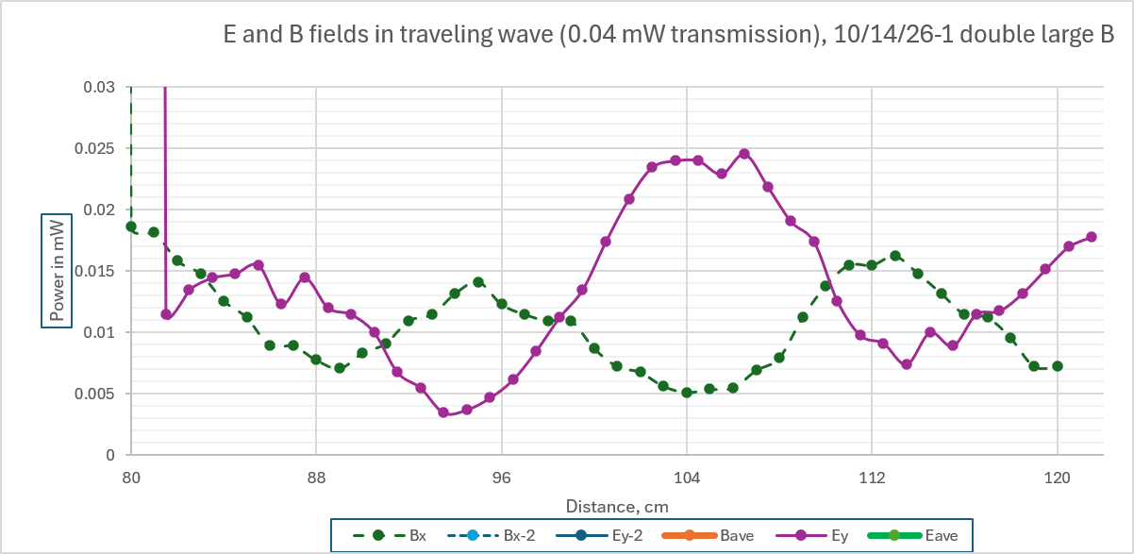

Slide 47
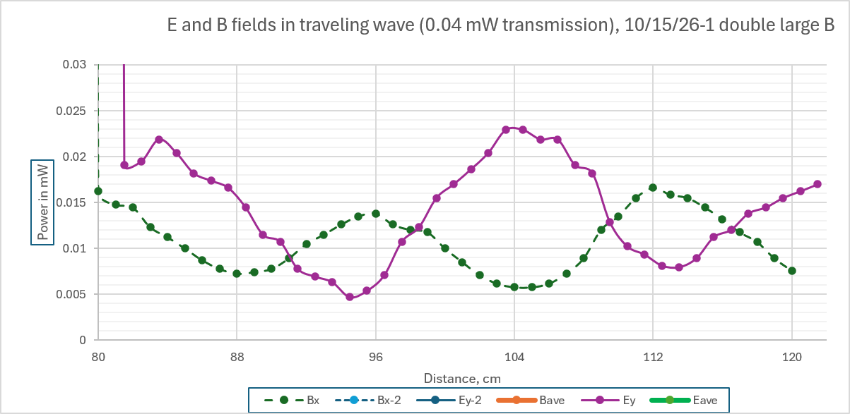

Slide 48
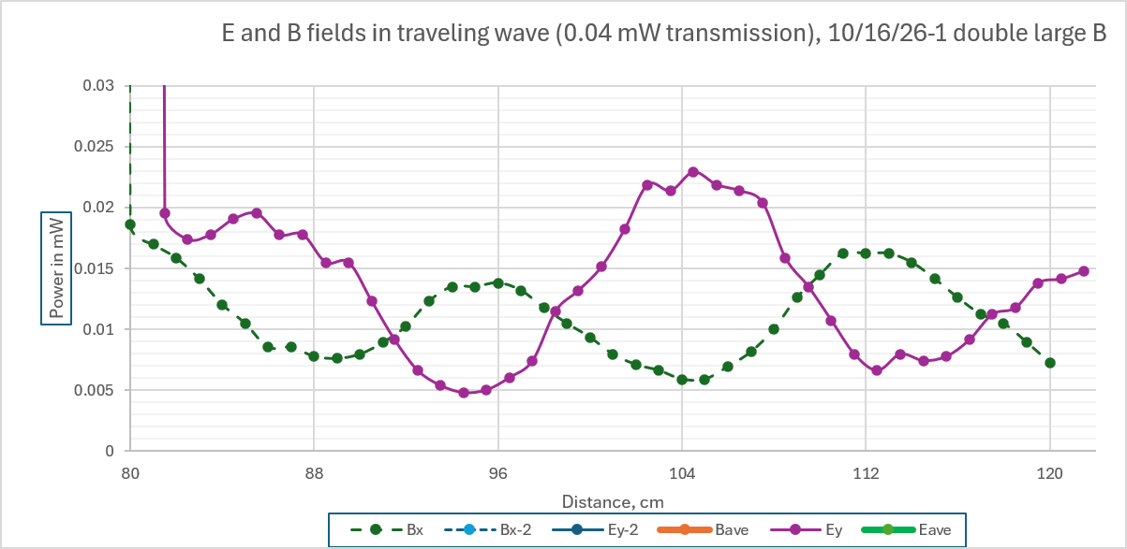

Slide 49


Slide 50
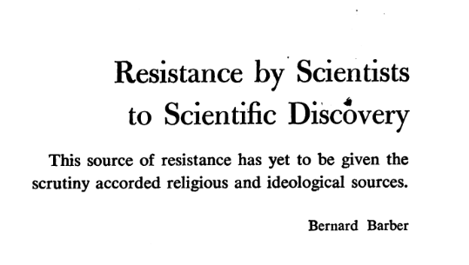
Science 134: 596 (1961)

Slide 51
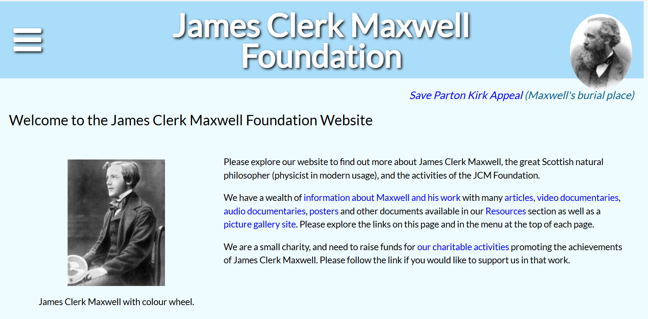

Slide 52


Slide 53
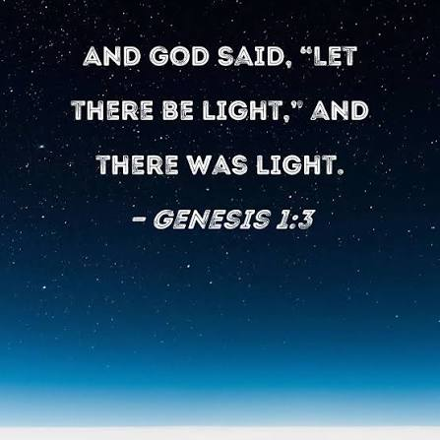


Slide 54


